Slide 2
John 4:3 So Jesus left Judea and went back once more to Galilee. 4 Now he had to go through Samaria. 5 So he came to a town in Samaria called Sychar, near the plot of ground Jacob had given to his son Joseph. 6 Jacob’s well was there, and Jesus, tired as he was from the journey, sat down by the well. It was about noon. 7 When a Samaritan woman came to draw water, Jesus said to her, “Will you give me a drink?” 8 (His disciples had gone into the town to buy food.)

Slide 3
9The Samaritan woman said to him, “You are a Jew and I am a Samaritan woman. How can you ask me for a drink?” (For Jews do not associate with Samaritans.)
10 Jesus answered her, “If you knew the gift of God and who it is that asks you for a drink, you would have asked him and he would have given you living water.” 11 “Sir,” the woman said, “you have nothing to draw with and the well is deep. Where can you get this living water? 12 Are you greater than our father Jacob, who gave us the well and drank from it himself, as did also his sons and his livestock?”

Slide 4
13 Jesus answered, “Everyone who drinks this water will be thirsty again, 14 but whoever drinks the water I give them will never thirst. Indeed, the water I give them will become in them a spring of water welling up to eternal life.”
What is this water and how can I get it
it is a spiritual life
10 “. . . he would have given you living water.” (The Holy Spirit - see Jn. 7:37-39

Slide 5
13 Jesus answered, “Everyone who drinks this water will be thirsty again, 14 but whoever drinks the water I give them will never thirst. Indeed, the water I give them will become in them a spring of water welling up to eternal life.”
What is this water and how can I get it
it is a spiritual life
It is an abundant life
14 “Whoever drinks the water I give them will never thirst. Indeed, the water I give them will become in them a spring of water welling up to eternal life.”

Slide 6
13 Jesus answered, “Everyone who drinks this water will be thirsty again, 14 but whoever drinks the water I give them will never thirst. Indeed, the water I give them will become in them a spring of water welling up to eternal life.”
What is this water and how can I get it
it is a spiritual life
It is an abundant life
Its source is Jesus
10 “If you knew the gift of God and who it is that asks you for a drink, you would have asked him . . .”

Slide 7
13 Jesus answered, “Everyone who drinks this water will be thirsty again, 14 but whoever drinks the water I give them will never thirst. Indeed, the water I give them will become in them a spring of water welling up to eternal life.”
What is this water and how can I get it
It is a must for a spiritual life:-
It is an abundant life
Its source is Jesus
It is a free gift
10 “If you knew the gift of God and who it is that asks you for a drink, you would have asked him and he would have given you living water.”

Slide 8
Let us see the situation the woman is in
She is lonely
She is poor
She is rejected
She is in need of
Love
Acceptance
A Startover
In General she is Thirsty

Slide 9
Her response , she got it but not everything
15 The woman said to him, “Sir, give me this water so that I won’t get thirsty and have to keep coming here to draw water.”

Slide 10
Her response, she got her physical need but not what matters most
He want to continue to probe till she get it
16 He told her, “Go, call your husband and come back.” 17 “I have no husband,” she replied. Jesus said to her, “You are right when you say you have no husband. 18 The fact is, you have had five husbands, and the man you now have is not your husband. What you have just said is quite true.”

Slide 11
Her response, she got her physical need but not what matters most
He want to point out why she is the way she is
I got it, but what about …. Tradition, place and rituals
19 “Sir,” the woman said, “I can see that you are a prophet. 20 Our ancestors worshiped on this mountain, but you Jews claim that the place where we must worship is in Jerusalem.”

Slide 12
Her response, she got her physical need but not what matters most
He want to point out why she is the way she is
I got it, but what about …. Tradition, place and rituals
21 “Woman,” Jesus replied, “believe me, a time is coming when you will worship the Father neither on this mountain nor in Jerusalem. 22 You Samaritans worship what you do not know; we worship what we do know, for salvation is from the Jews. 23 Yet a time is coming and has now come when the true worshipers will worship the Father in spirit and in truth, for they are the kind of worshipers the Father seeks. 24 God is Spirit, and his worshipers must worship in spirit and in truth.”

Slide 13
Her response, she got her physical need but not what matters most
He want to point out why she is the way she is
I got it, but what about …. Tradition, place and rituals
One more thing
25 The woman said, “I know that Messiah is coming. When he comes, he will explain everything to us.”

Slide 14
Her response, she got her physical need but not what matters most
He want to point out why she is the way she is
I got it, but what about …. Tradition, place and rituals
One more thing
25 The woman said, “I know that Messiah is coming. When he comes, he will explain everything to us.” 26 Then Jesus declared, “I, the one speaking to you—I am he.”

Slide 15
Her response, she got her physical need but not what matters most
He want to point out why she is the way she is
I got it, but what about …. Tradition, place and rituals
One more thing
The woman is thirsty and she has tried everything to get satisfaction
Multiple partners
Tradition
Future prophesies

Slide 16
Her response, she got her physical need but not what matters most
He want to point out why she is the way she is
I got it, but what about …. Tradition, place and rituals
One more thing
No tradition, no cleaning up yourself first, no waiting
Admit your thirst and ask for the living water

Slide 17
This living water is not only for us to keep
28 Then, leaving her water jar, the woman went back to the town and said to the people, 29 “Come, see a man who told me everything I ever did. Could this be the Messiah?” 30 They came out of the town and made their way toward him . . .

Slide 18
This living water is not only for us to keep
39 Many of the Samaritans from that town believed in him because of the woman’s testimony, “He told me everything I ever did.” 40 So when the Samaritans came to him, they urged him to stay with them, and he stayed two days. 41 And because of his words many more became believers.

Slide 19
Tip for us to give away the living water
Look beyond our daily living activities; many thirsty people around us
35 Don’t you have a saying, ‘It’s still four months until harvest’? I tell you, open your eyes and look at the fields! They are ripe for harvest.

Slide 20
Tip for us to give away the living water
Look beyond our daily living activities; many thirsty people around us
Our neighbors : beyond the daily struggle
Around the world : beyond the headlines

Slide 21
Tip for us to give away the living water
Look beyond our daily living activities; many thirsty people around us
Our neighbors : beyond the daily struggle
Around the world : beyond the headlines
What he is saying is: wherever you look there are thirsty people
Besides were we get partner with Jesus, there is a reward attached to it
31His disciples were saying to him, "Rabbi, eat something!"
32But he said to them, "I have food to eat that you know nothing about."

Slide 22
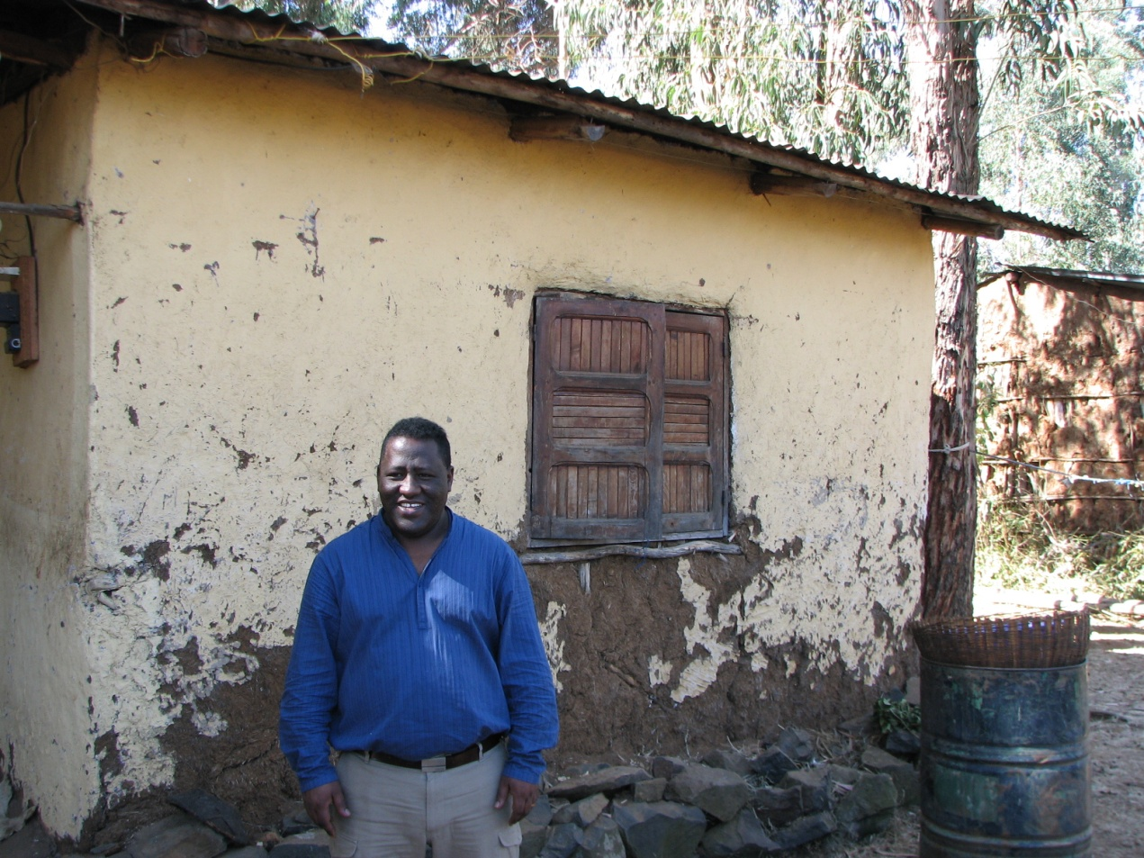
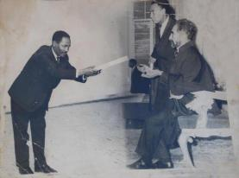
My Story
Notes:
Underground meetings in my house, recruited many after we discovered we were going to be excommunicated
Grew up in the Ethiopian Orthodox Church
Born and raised in the north from an influential family
My father strong orthodox, member of the parliament during Haile Selassie, very much respected and liked by the people, worked also with Derge
High school years- active in the orthodox church
Worked for the orthodox church after high school
Finding out I no longer believe in Mary!!!!
I decided to follow my newly discovered faith and even lead it

Slide 23
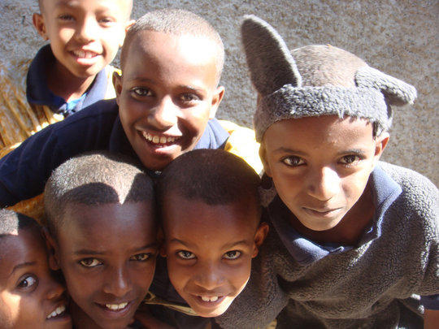
History
One of the ancient countries of the world
More than 85 local dialects spoken in the country- *
Population 105 million with 80% living in rural areas
The median age is 16.5 (USA is 37)
Orthodox 43.5%, Muslim 33.9%, Protestant 18.6
Notes:
Language- only written language in Africa- > 85 local dialects
Two points on this percentages, 43.5 and 18.6

Slide 24
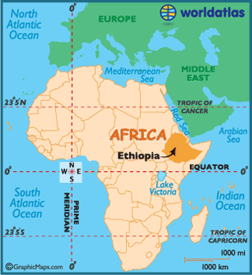
Notes:
Ethiopia is located in East Africa

Slide 25
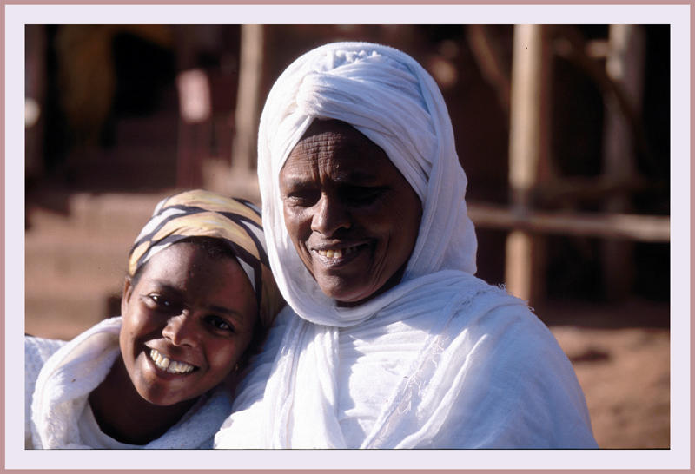
Northern Ethiopia
40 million Amhara and Tigray people < 0.5% reached
The site of all the ancient kingdoms
Birth place of orthodoxy as well all political and cultural identity of Ethiopia
Notes:
Very resistant to the gospel in the past
The Amaharic and Tigray make up one of largest unreached people groups in the world

Slide 26
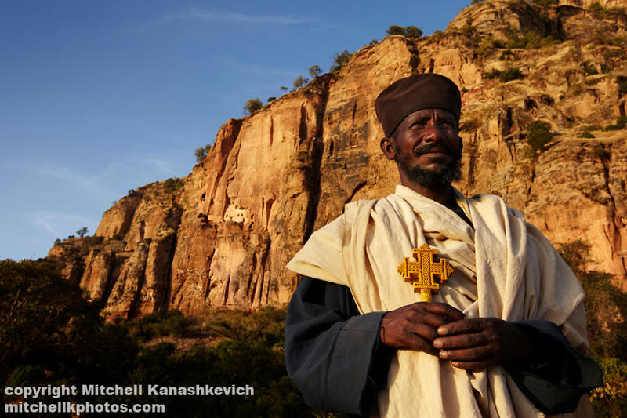
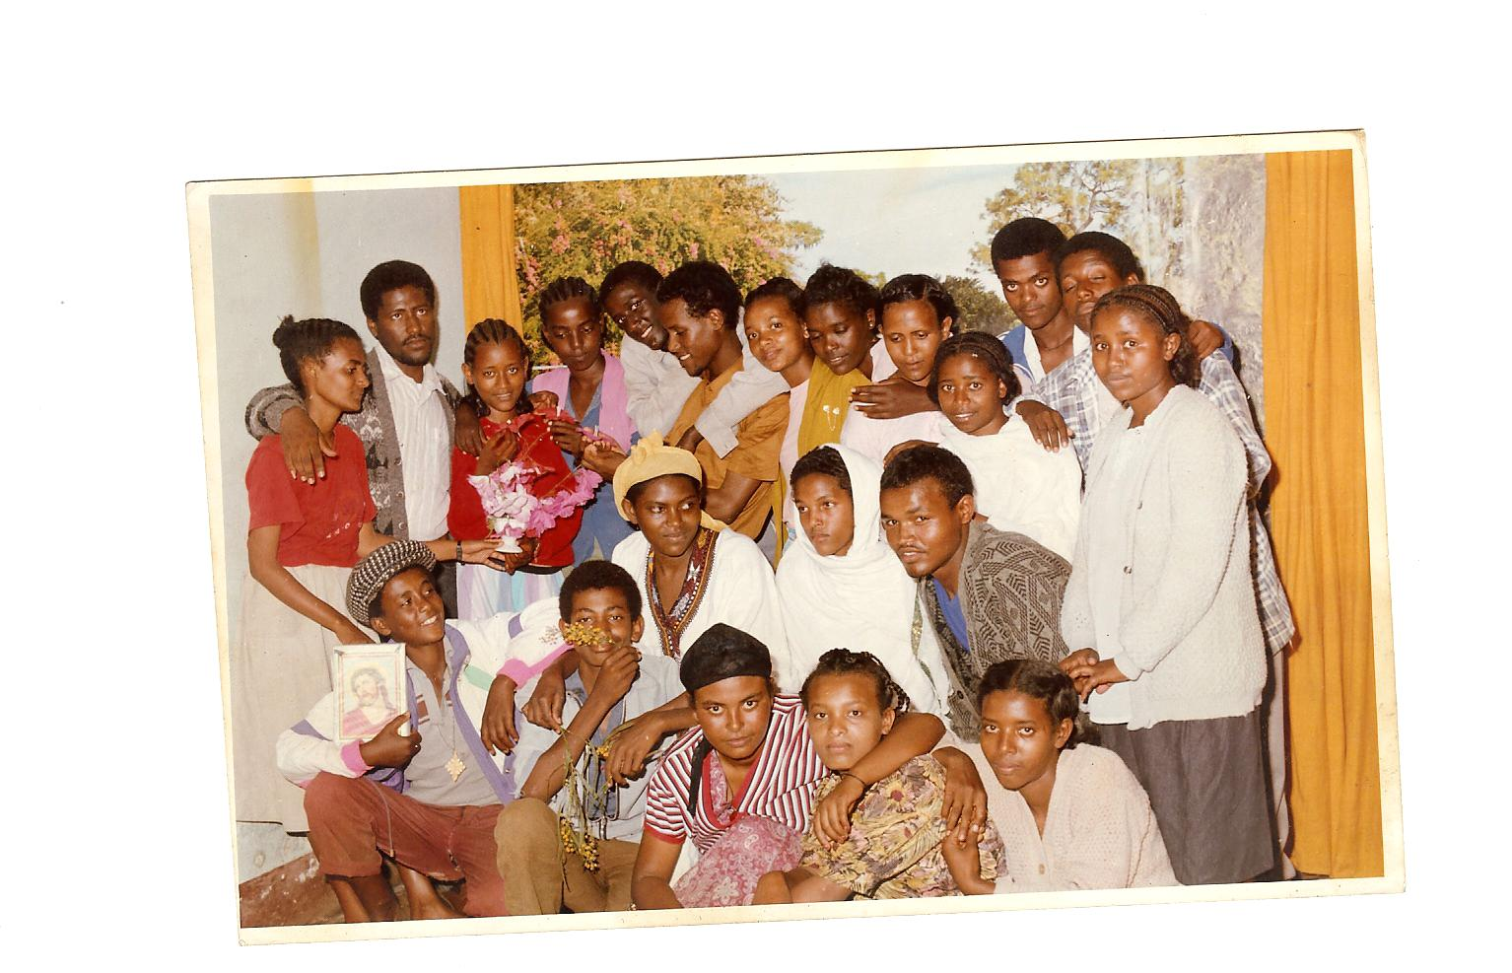
A Movement Begins
Notes:
Secret bible study in my home
Our number increased
Problem with authorities - The secret is out- confronting the orthodox clergy
Excommunication
27 young people got excommunicated - the oldest 22 among them my future wife GENET
Deciding what is next?
First thing first- who are we and what do we believe- 5 points
To be or not to be?- the decision to stay as an alternative to traditional evangelicalism
Finding a place to meet- the Muslim solution
Legal issues- my father’s help
Organizing the church- God was faithful
Help lead the church for 2 years
our number - more than 100 in 2 years

Slide 27
Our Vision
To mobilize, equip, and plant a network of lay-led multiplying home churches throughout the Amhara and Tigray regions of Northern Ethiopia with the goal to remove the Amhara and Tigray from the list of unreached peoples.
Notes:
Approximately 5000 people in 1 Kebele

Slide 28
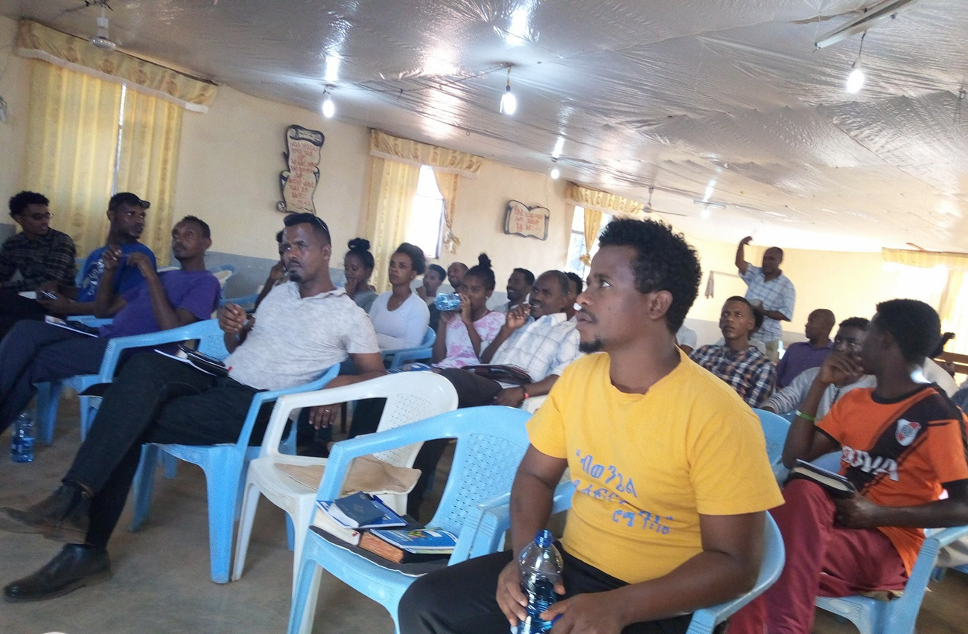
Last six years So, what is God doing now?
168 new believer in the last 4 months
18 Different localities from 2
961 in fellowship from 210
51 HCs from 11
21 Planters from 2
94 HC leaders from 30
376 in Discipleship
Notes:
Why is this vision within reach?
The spiritual climate is open to the gospel. Nearly every Ethiopian is monotheistic and considers themselves to be either Christian (65%) or Muslim (35%). People often attend the Orthodox Church out of obligation, and many do not see a future for themselves within this Church. However, they remain spiritually minded and are open to personal evangelism.
The family household structure (oikos) makes it easy to multiply home churches. People naturally congregate in the Ethiopian household; they share meals and spend evenings in conversation. These households could easily host up to 50 people for bible studies and fellowship, making expensive buildings unnecessary.
The socio-political situation can facilitate church planting over a wide geographical area. Many Christians hold government professions, drawing both a state salary and considerable social influence. This influence can range from large cities to small villages. Ethiopia enjoys freedom of religion, including the right to proselytize and assemble.
The consensus of the Bahir Dar and Addis Ababa groups strongly supports this vision. These groups are composed of young professionals who are eager to be trained and mobilized.
The country is more open than any time in it’s history
Generational- openness
Political- relatively peaceful
Economical- emerging middle class
Governmental structure and developmental policy
Rekindled sense of purpose in the church
Time to fight for the imagination of young people before it is too late
- Unity of purpose in the church ( we all have been waiting for this time)
The kind of people who are currently in our church- upwardly mobile young professionals
The government developmental structures- schools, health care facilities, agricultural development workers- from cities to small kebeles
relatively accessible with transportation and suitable governmental structure
Even if there is resistance to the gospel in the north, freedom of worship is protected by the constitution
The greater majority of our target population has an orthodox back ground, which makes it less resistance to the central claim of the gospel
a common language

Slide 29
How can I be part of this vision?
Prayer Support
For our family
Pray for the church leaders
Pray for continued peace in the country
Pray for the movement of the spirit in winning souls- especially the youth
Join our prayer e-group
Send an e-mail to
XCF-Ethiopia+subscribe@googlegroups.com
Notes:
Partnership
Me and my family has decided to go back and be a part of this vision, we need partners, to be send
We are planning to be in Ethiopia by the end of summer 2013

